Slide 1
Discovering Optimal Models For Real Estate Prices Prediction Using Linear & Non-Linear Regression Techniques
Areeb Waseem (18L-1823)
Rehman Shahid (18L-1890)
Samama Imtiaz Butt (18L-1882)

Slide 2
ABSTRACT
We know that real estate prices follow specific trends that depend on location, condition, features etc. This project aims at applying advanced Regression Techniques to predict the Real Estate Sale Prices given a set of features. The dataset will be a combination of several features such as interior, exterior, area, location, heating, number and condition of rooms etc. We will then train our models depending on these features and the respective sale prices. In the end we will run our model to predict house sale prices and test the accuracy of our results.

Slide 3
INTRODUCTION
The goal of this project is to predict Real Estate Prices in the Houses sector.
The Sale Prices follow certain tendencies of better condition leading to better selling price.
Dataset is taken from an active Kaggle competition which consists of different characteristics of the houses in a csv file.
Detailed analysis of the Dataset.

Slide 4
INTRODUCTION
We will first Pre-process Dataset to make it appropriate for building our model.
Then we will train our model by applying different Regression Algorithms.
Next, we will test our model on the dataset and perform an analysis of the predictions of the prices.
In the end, we will do a comparative analysis of different regression algorithms used in our model.

Slide 5
PROBLEM STATEMENT
The task is to build a model based on Machine Learning techniques that takes imperative features of the houses and predict their selling price. Our proposed solution will include different Machine Learning algorithms like ANN, Gradient Descent, Stochastic Gradient Descent, Random Forest Regression, Multi-variate Regression, Kernel Ridge Regression etc. and analysis based on their results. We will be implementing the solutions in raw python & also use libraries in some cases for building an efficient prediction model.

Slide 6
Dataset Analysis
Dataset consists of several features of the houses and respective prices. Data is strongly & linearly correlated which forms the basis for Machine Learning models. The Sale Price shows following trends:
Deviate from the normal distribution
Have appreciable positive skewness
Sales Price and GrLivArea have a linear relationship
Sale prices increase per year

Slide 7
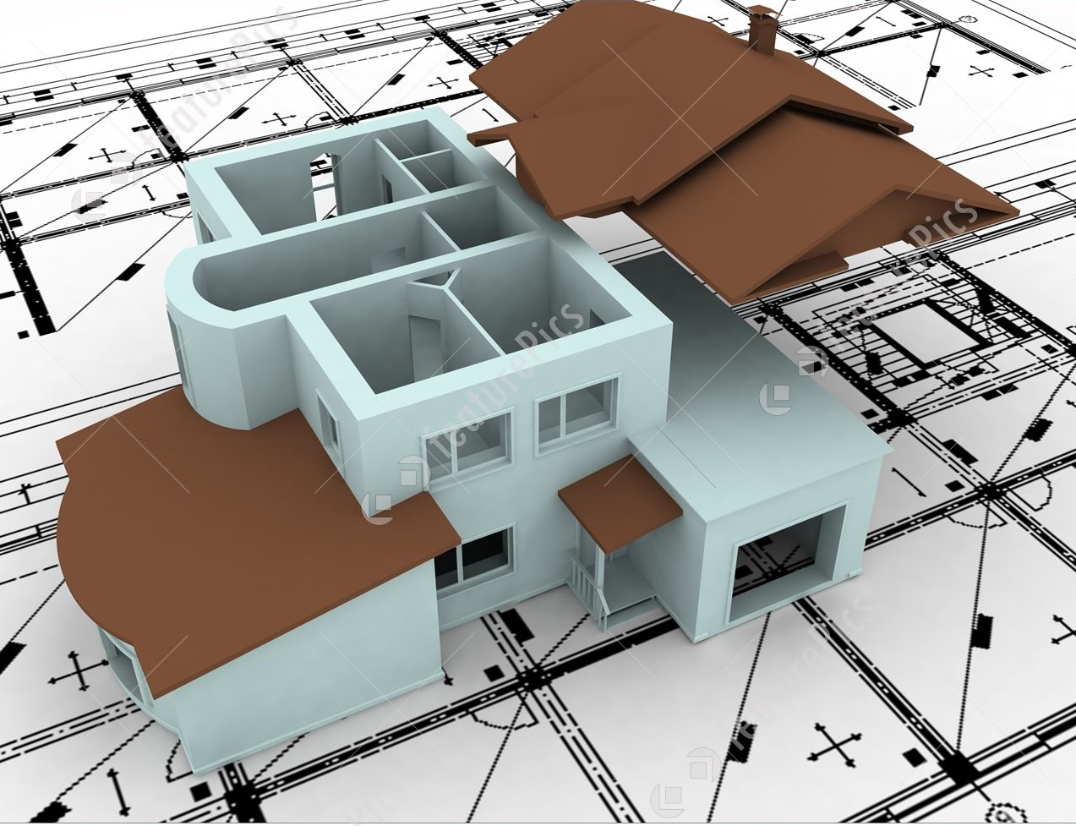
Deterministic Features for Price Prediction
Sale Price
Building Class
Building Location
Construction Type
Condition / Quality
Utilities / Access
Year Built
Square Feet
# of Floors
# of Beds / Kitchens
Roof Type
Garage Area

Slide 8
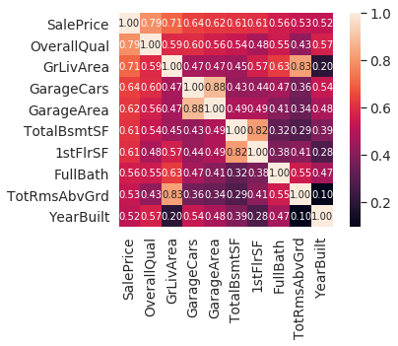
Highly Correlated Features
Sale Price
OverallQual
GrLivArea
GarageCars
TotalBsmntSF
1stFlrSF
FullBath
TotRmsAbvGrd
YearBuilt

Slide 9
Dataset Preprocessing
Handling Missing Values & Type Conversions.
Standardizing Numeric Data.
Handling Skewed Data.
Converting Categorical Data to Dummies.
Split train & test features.

Slide 10
Feature Name | Conversion
MsSubClass | toStr
MsZoning | Fill Na with most common feature (mode)
LotFrontage | Fill Na with Mean
Alley | Fill Na with No Access
OverAllCond | toStr
MasVnrType | Mode
Bsmt | Fill Na with No Basement
TotalBsmtSF | Fill Na 0
Electrical | Mode
KitchenAbvGr | toStr
KitchenQual | Mode
FireplaceQu | Fill Na with NoFp
Garage | Fill Na with NoGRG
SaleType | Mode
YrSold | toStr
MoSold | toStr
Dataset Preprocessing
Handling
Missing Values
Type Conversions

Slide 11
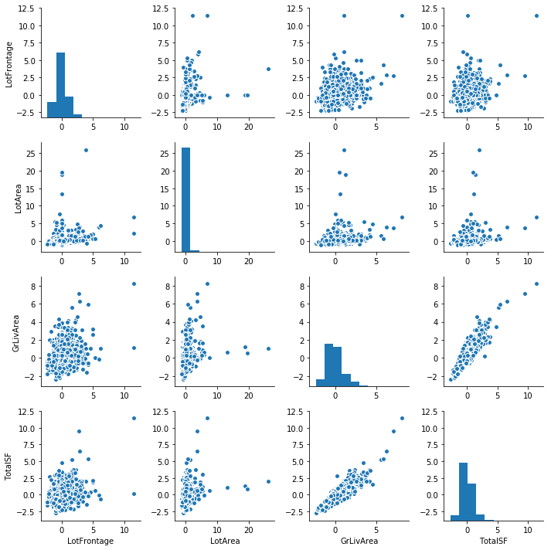
Dataset Preprocessing
Standardizing Numeric Data by taking the mean of each feature, subtracting it from each entry and dividing it by standard deviation.

Slide 12
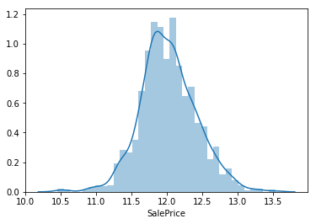
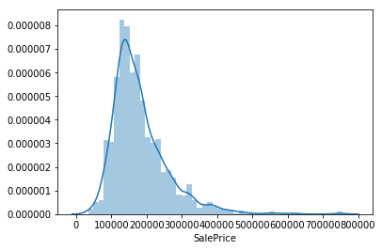
Dataset Preprocessing: Handling SkewedData
The Sale price was skewed right and to make it symmetric we took log transform.

Slide 13
Dataset Preprocessing: Categorical Data to Dummies
Converting categorical data into numerical form.
Replacing missing values by baseline dummy values.
We handled the features of conditions and exteriors by converting their categorical data to numeric form by placing dummies.
Data type used for this purpose was float.

Slide 14
Dataset Preprocessing: Split Train & Test Validation Sets
Split the Dataset randomly into Train and Test sets.
Train/Test split was 90% & 10% respectively.

Slide 15
ALGORITHMS

Slide 16
Regression Algorithms
Multivariate Regression
Gradient Descent
Stochastic Gradient Descent
Ensembled Learning
Random Forest Regression
Multi-Layer Perceptron
Kernel Ridge Regression

Slide 17
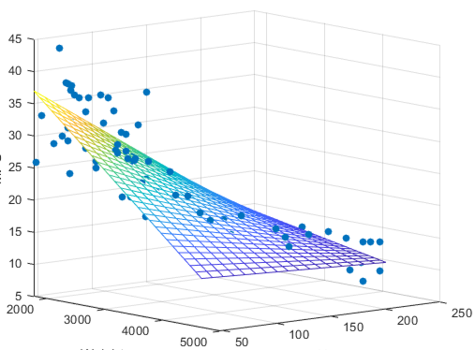
1) Multivariate Regression
Learns linear decision boundary using normal equation.
Provides optimal solution for linear modeling.
Best in cases where data set is not very large as computational complexity is reduced.
For very large datasets, space complexity cripples the model.

Slide 18
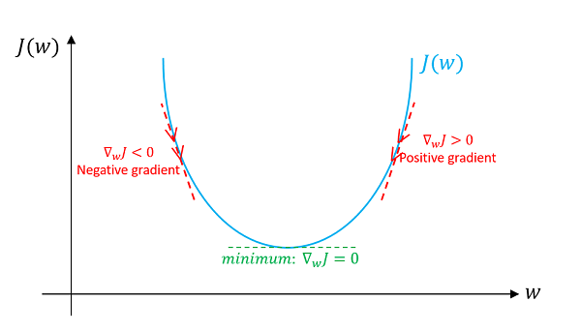
2) Gradient Descent
It is an optimization algorithm used to find the values of parameters (coefficients) of a function (f) that minimizes a cost function (cost).

Slide 19
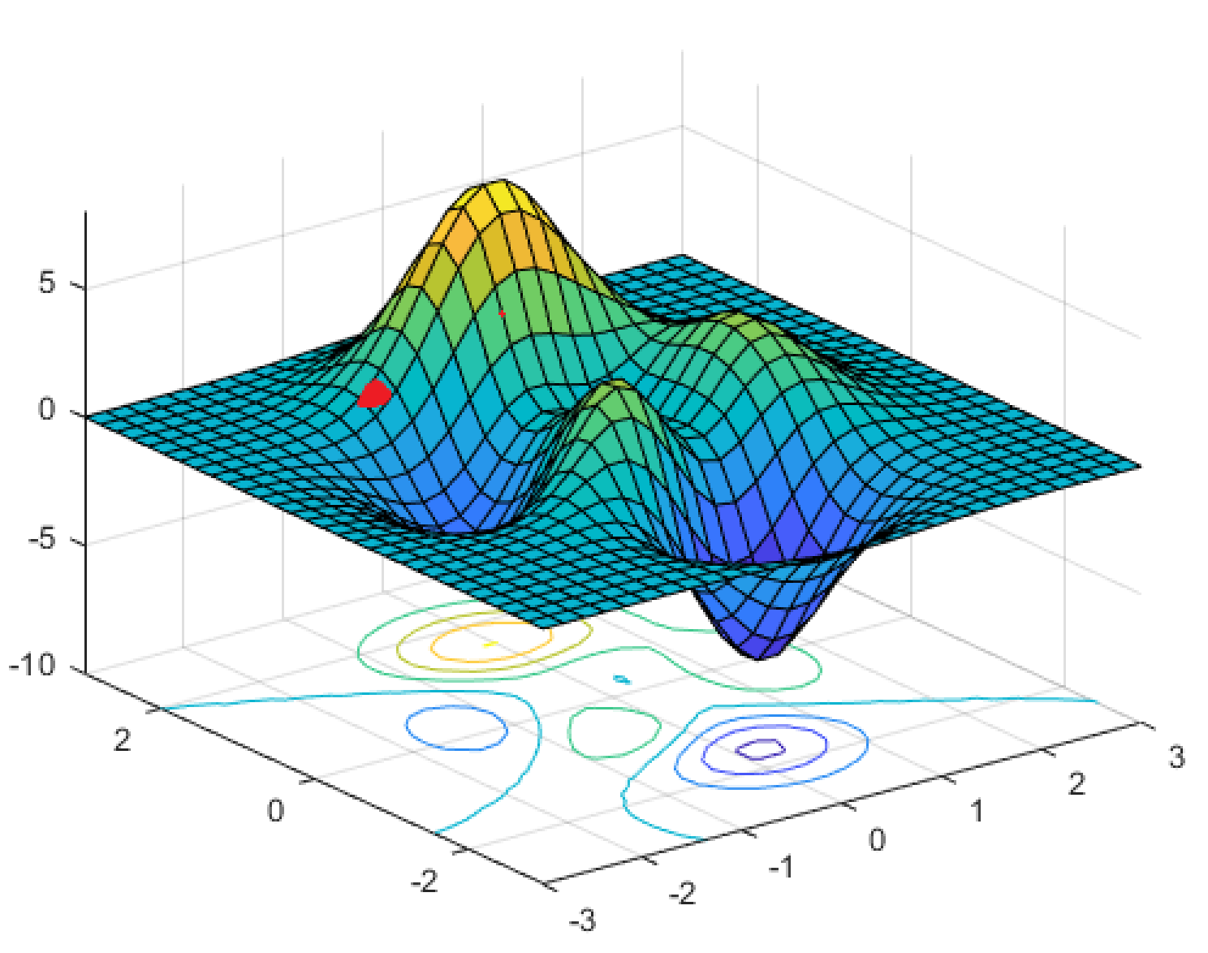
3) Stochastic Gradient Regression
Stochastic gradient descent performs better than batch gradient descent.
Better at finding global minimums as compared to local minimums.

Slide 20
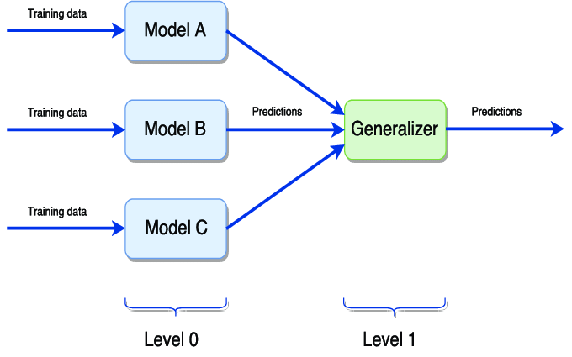
4) Ensembled Leaning

Slide 21
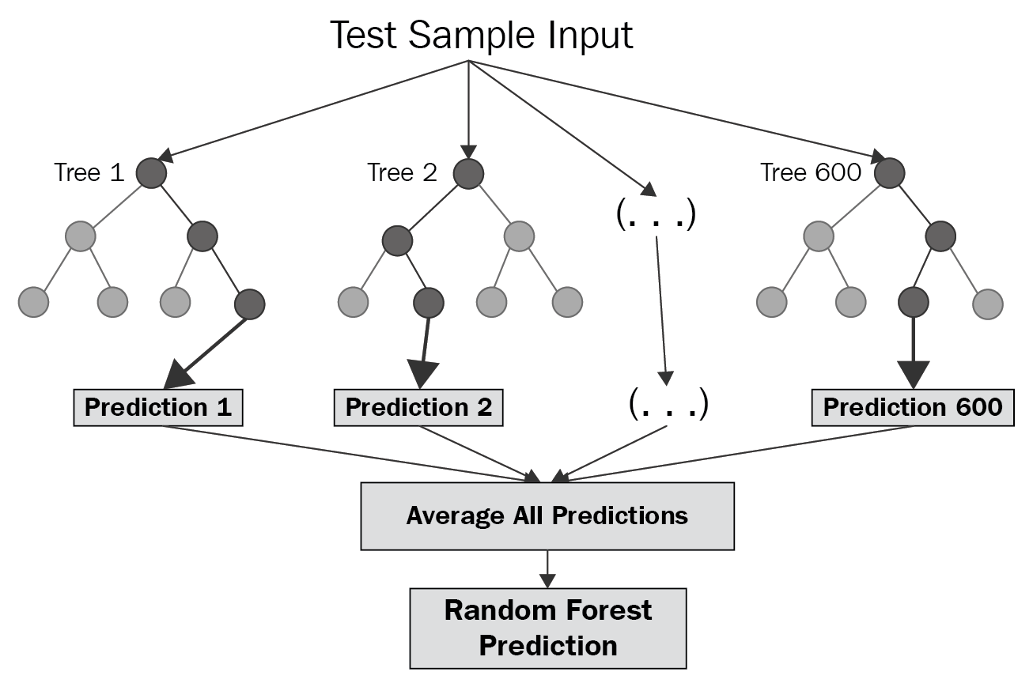
5) Random Forest Regression
Enhances decision tree learning.
Learns multiple decision trees on different feature splits.
Ensembles the results for regression.
Avoids overfitting by not relying too heavily on specific features.

Slide 22
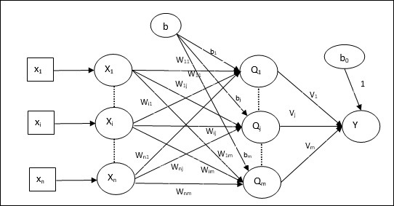
6) Multi-Layer Perceptron
Multiple hidden layers.
Linear activation.
Backpropogation.
Learns non linear decision boundary.

Slide 23
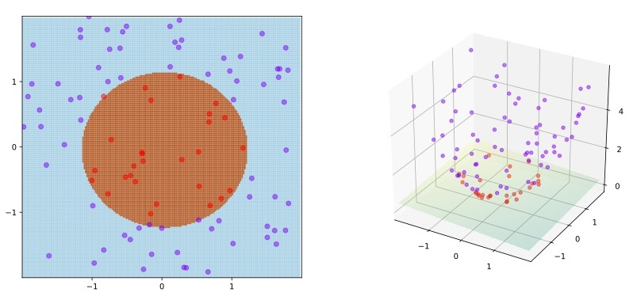
7) Kernel Ridge Regression
Combines kernel trick with Ridge regression.
Maps data points to higher order domain inexpensively.
Linear hyperplane in higher order domain is indeed a nonlinear decision boundary in lower order domain.

Slide 24
RESULTS & ANALYSIS

Slide 25
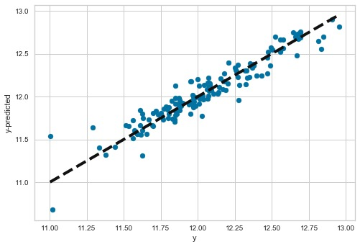
RESULTS: Multivariate Regression
The results are reasonable.
RMSE: 0.1206
Better as compared to Batch & Stochastic Gradient Descent.
Optimal Linear Decision Boundary learned but can’t be compared to non-linear model.

Slide 26
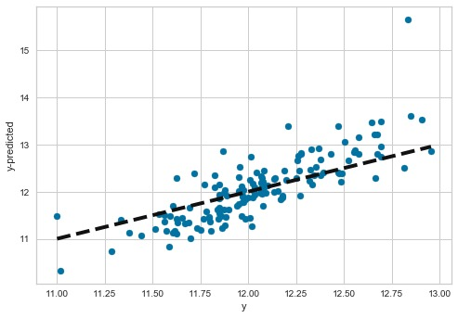
RESULTS: Gradient Descent
The model performed the worst as compared to others.
RMSE: 0.4502
Batch processes are more prone to settling at local minima rather than global minima.

Slide 27
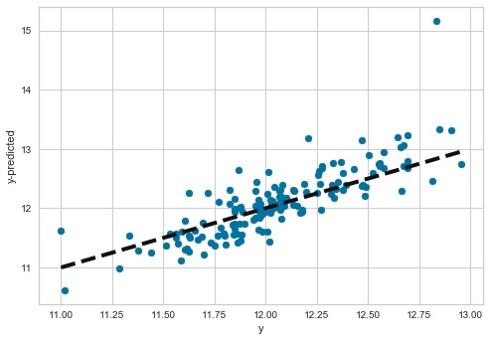
RESULTS: Stochastic Gradient Descent
The model performed better than Batch Gradient Descent.
RMSE: 0.3451
Stochastic processes iteratively modify weights giving them a high chance of finding global minima.

Slide 28
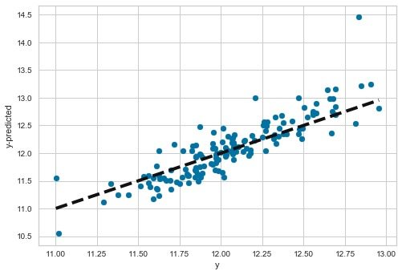
RESULTS: Ensembled Learning
The results were in between of 3 of our linear models.
RMSE: 0.2695
Ensembling shows that different models can be combined to produce better results.

Slide 29
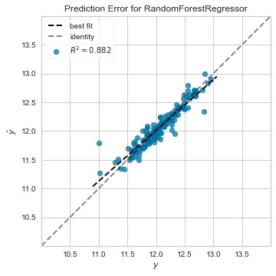
RESULTS: Random Forest Regression
There is a sudden jump in accuracy as we shift to non-linear models.
RMSE: 0.1256
Random Forest combines multiple decision trees to produce an accurate averaged non-linearly regressed output.

Slide 30
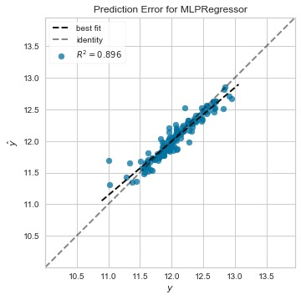
RESULTS: Multi-Layer Perceptron
A combination of multi-layered perceptrons including hidden layers enable the model to learn a non-linear function.
RMSE: 0.1195
Better than all of the models except Kernel Ridge Regression.

Slide 31
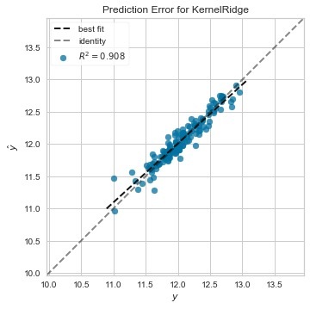
RESULTS: Kernel Ridge Regression
The model greately enhances the optimal linear multi-variate regression by mapping the data points to a higher order domain and learning a linear function which eventually results in a non-linear function in a lower order domain without any increased computation expense.
RMSE: 0.1126
OUTPERFORMED

Slide 32
CONCLUSION
Non linear methods like ANN, Kernel Ridge and Random Forest perform better than linear models like Multivariate and Gradient Descent Regression.
The results back our conclusion as the RMSE fell to 0.1126 in Kernel Ridge while Batch Gradient Descent had 0.45 which is a big difference.
We can conclude that for standardized variables with reasonable sized datasets, Kernel Ridge performs the best.
In cases, where datasets are very large the Kernel Perceptron will inevitably be the best possible solution as the space complexity of Ridge Regression will be very high.

Slide 33


